Slide 1
Activity-2
PSP-vs-TSP
Non_Technical Round
Task: Identify the proverb of given pictures

Slide 2



Doms

Slide 3

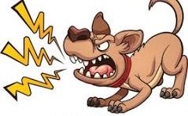

2. WhistleBlowers

Slide 4


3. Goodness

Slide 5


4. Level of gain

Slide 6



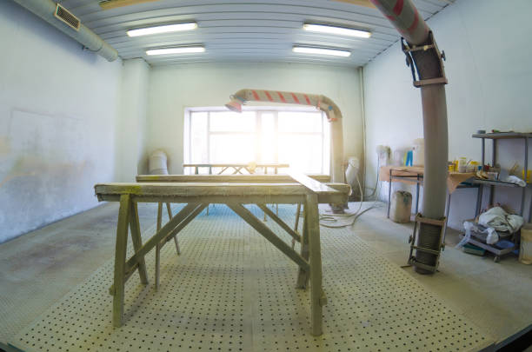
5. Be progressive

Slide 7

6. Visibility Vs Worthiness

Slide 8

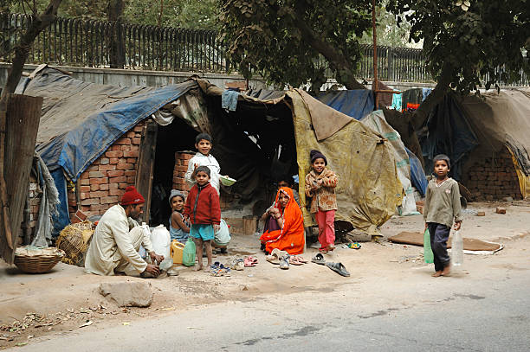



7.poor x rich

Slide 9
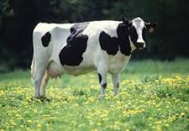

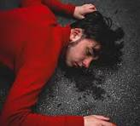

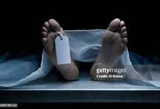
8. Be brave

Slide 10




9 underEstimation

Slide 11
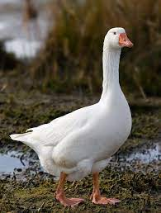

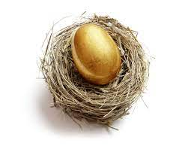
10 Income

Slide 12

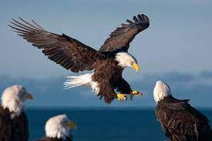

11. think big

Slide 13

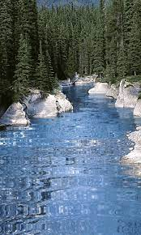

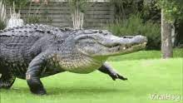
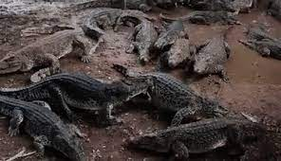
12. silent dangers

Slide 14


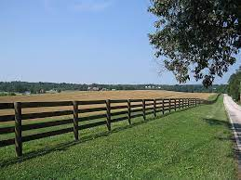
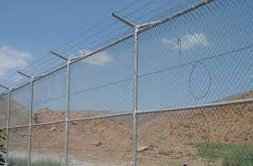
13. Enjoy the moment

Slide 15



14. make first step

Slide 16
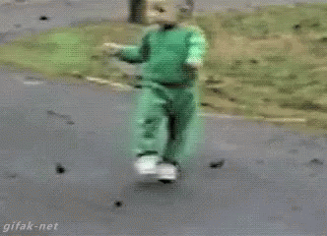
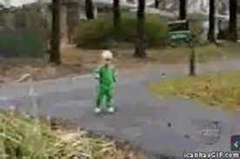
15 Resilence

Slide 17


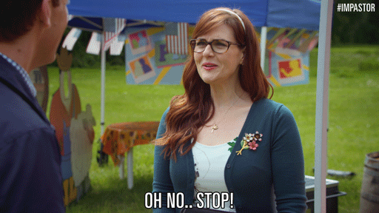


16. Vice

Slide 18



17. Marketing

Slide 19

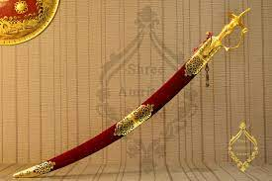
18. Powerful one

Slide 20
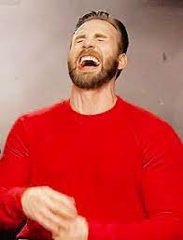

19. Good for health

Slide 21
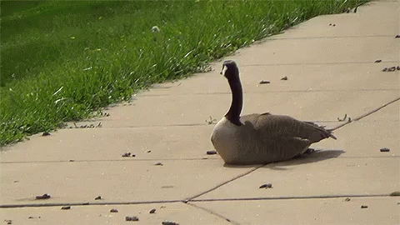



20. Truth and Fact

Slide 22


20. Right opportunity

Slide 23
References
200+ Common Proverbs in English [with Meaning and Example] | Lemon Grad

Slide 24
THANK YOU

